Slide 1
Person Detection and Tracking using Binocular Lucas-Kanade Feature Tracking and K-means Clustering
Chris Dunkel
Committee:
Dr. Stanley Birchfield, Committee Chair
Dr. Adam Hoover
Dr. Richard Brooks

Slide 2
The Importance of Person Detection
Critical technology for machine/human interaction
Basis for future research into machine/human interaction
Many applications:
  Person avoidance by robots in a factory
  Following of people with heavy equipment or tools
  Autonomous patrolling of secure areas

Slide 3
Other Approaches
Color Based ^{[1,2,3,4]}
  Simple, fast
  Can be confused by similar-color environments
Optical Flow/Motion Based^{[5,6]}
  Robust to color or lighting changes
  Person must move relative to background
Dense Stereo Matching^{[7]}
  Constructs accurate 3D models of the environment
  Slow, may have difficulty with people near the background
Pattern Based^{[8]}
  Low false positive rate. Works well on low-resolution images in adverse conditions
  Slow (4 fps). Requires stationary camera.

Slide 4
Our Approach
Inspired by the work of Chen and Birchfield ^{[12]}
Stereo based Lucas-Kanade ^{[9, 10]}
  Detect and track feature points
  Calculate sparse disparity map
Segment scene using k-means Clustering
Detect faces using Viola-Jones detector ^{[11]}
Detect Person using results of k-means and Viola-Jones
Track Person using modified detection procedure

Slide 5
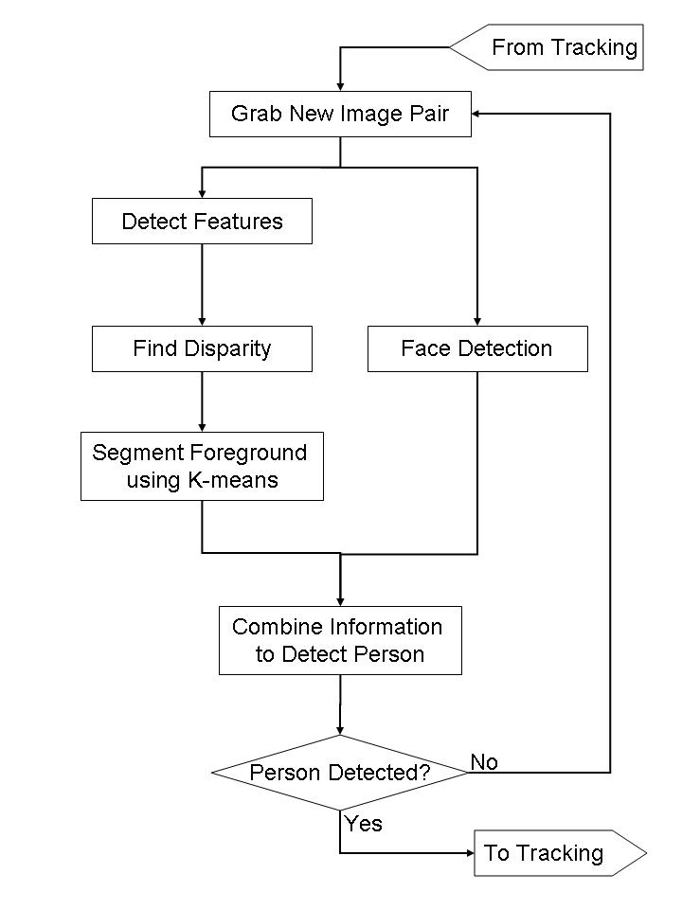

Person Detection

Slide 6
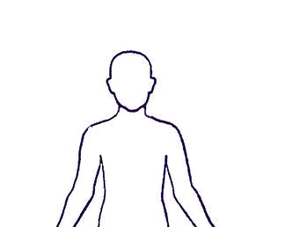
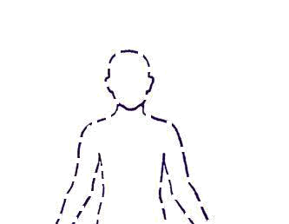


Lucas-Kanade
Originally intended for fast image registration
Selects features based on texture:
  Coefficient matrix based on covariance of image gradients within a window around the proposed feature
  Eigenvalues of coefficient matrix must be large and similarly valued
Tracks features based on error:
  Error between image intensities
  L₂ Norm (Sum of Squares) used to define error
  Small changes between frames assumed
(0,0)
d
y
d
x

Slide 7
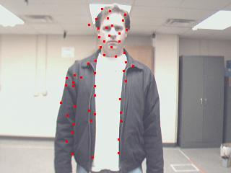
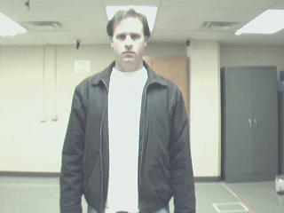
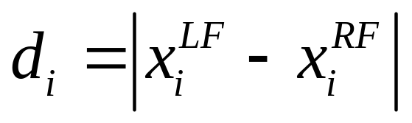
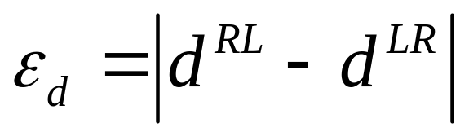
Sparse Disparity Map Generation
Track points from left frame to right frame
Track points back from right frame to left frame to check disparity
Keep point if ε_{d} is less than user-defined threshold

Slide 8
Tracking Velocity
Change in feature location in (x,y,d) recorded from frame to frame, giving (Δx,Δy,Δd)
Each feature located in R⁶ space: (x,y,d,Δx,Δy,Δd)
Idea is to segment for motion, as well as position
Δ values provide an extra layer of classification, but not enough to stand on their own

Slide 9


Slide 10
Clustering Methods
All methods iterative
K-means
  Simple, effective
  Assigns features to clusters based on distance to cluster means
Fuzzy C-means
  More complex
  Features weighted for each cluster based on distance to cluster means
Expectation Maximization (EM)
  General clustering algorithm
  Can be used for many applications
  Cluster membership based on probability density function defined by user

Slide 11
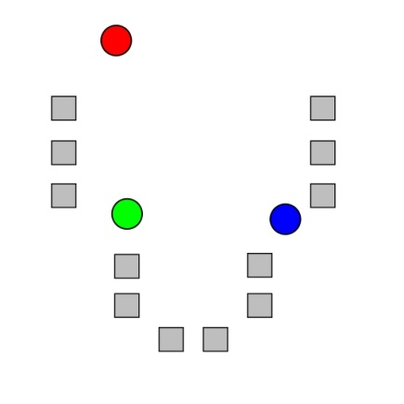
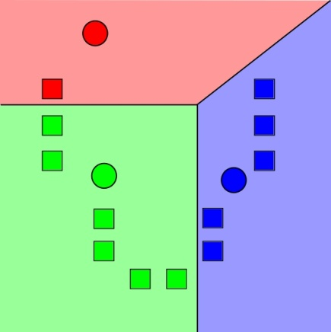
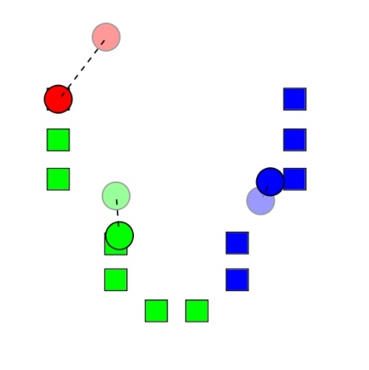
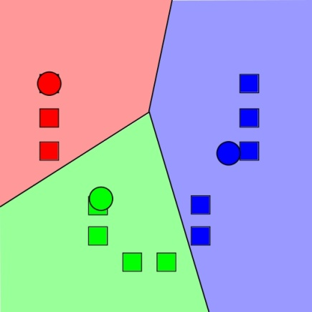
K-means
Select initial cluster means
Assign points to clusters based on distance to means
Recalculate means using new cluster membership
Repeat steps 2 and 3 until clusters are stable
1
2
3
4

Slide 12
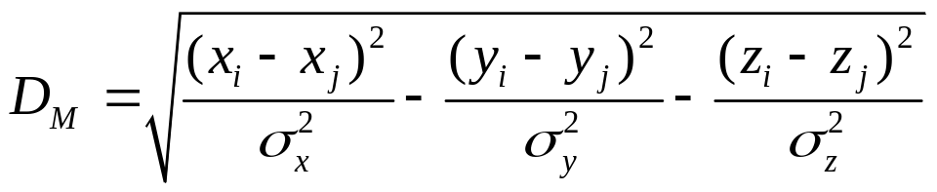
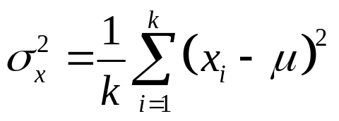
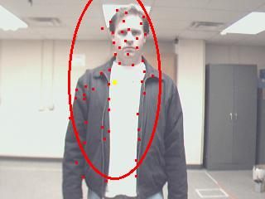

Mahalanobis Distance
Similar to Euclidean distance
Weights each dimension by variance, σ²
where
(0,0)
(0,0)
y
d
x
x

Slide 14
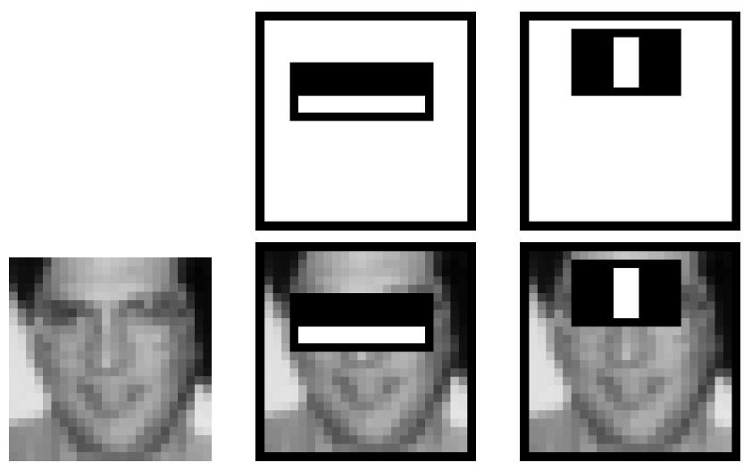
Viola-Jones Face Detection
General method for fast object detection
Integral images used for fast feature evaluation
  Features reminiscent of Haar basis functions
  AdaBoost used to select best classifier
Haar-based Classifiers Overlaid on Sample Faces
Use cascade structure to combine successively complex classifiers
  Simple classifier used to eliminate large regions of the image from consideration
  Increasingly complex classifiers used to eliminate remaining features
  Features judged based on image intensity

Slide 16
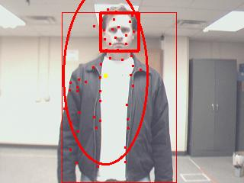
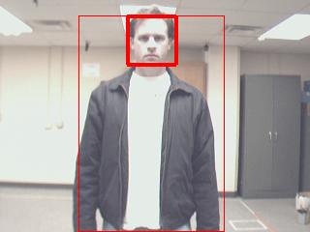
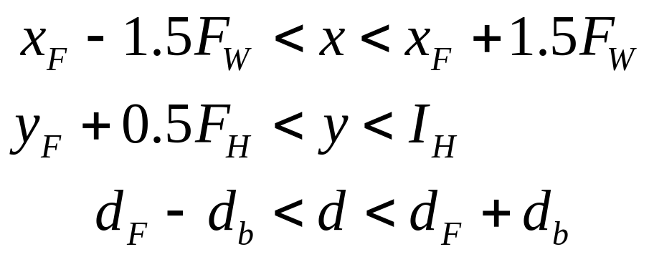
Detecting the Person
Create bounding box based on face
Merge results from face detector and clustering
Remove points that qualify as outliers
Enter Tracking if person found

Slide 17
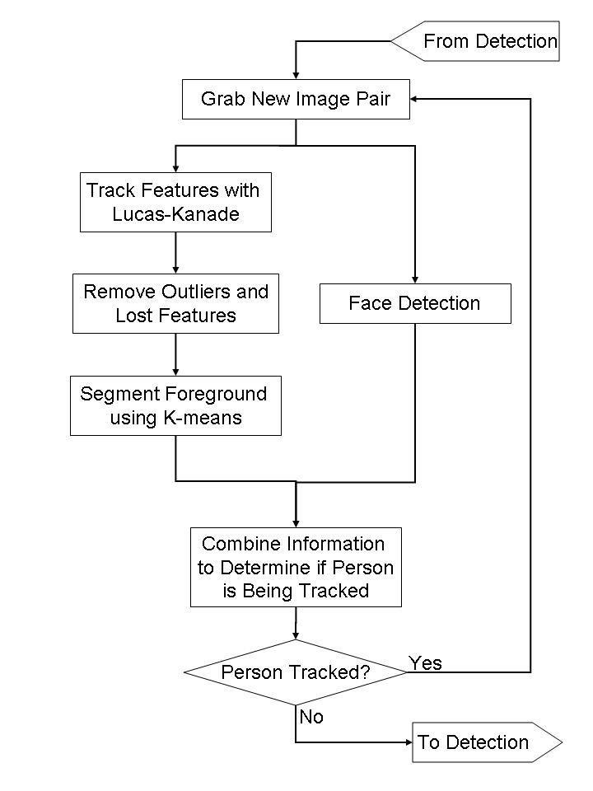
Person Tracking

Slide 18
Updating the Face
Updates face location when not running Viola-Jones
Update position based on movement in tracked person from t-1 to t
Update size based on change in person disparity

Slide 19
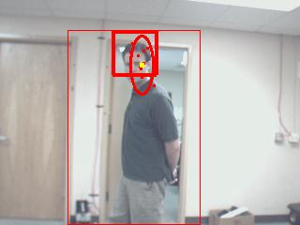
Losing the Person
Number of feature points in person cluster saved at the start of tracking
Number of good feature points monitored throughout tracking
Person “lost” if number of points tracked drops below a user-defined percentage of the original number (25% in our case)
A person in danger of being lost

Slide 20
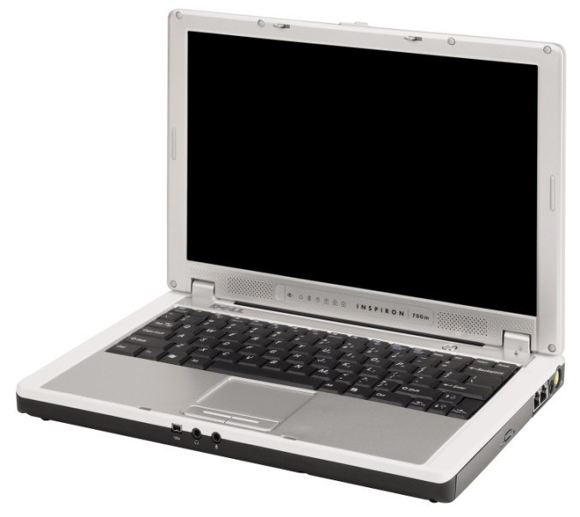
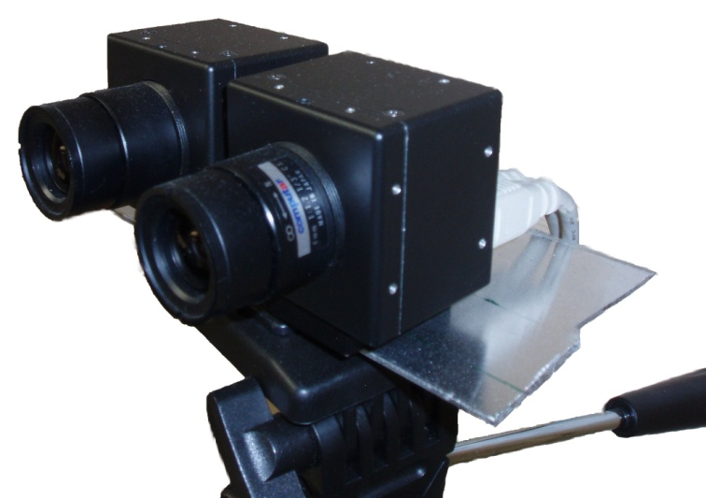
System Overview
Computer Hardware:
  Dell Inspiron 700m laptop
  1.6 GHz Intel Centrino processor
Computer Software:
  Windows XP Service Pack 2
  Microsoft Visual C++ 6.0
  Blepo Computer Vision Library
Cameras:
  ImageSource DFK 21F04 CCD
  Daisy-chain Firewire (IEEE 1394) computer interface
  320 x 240 Resolution

Slide 21
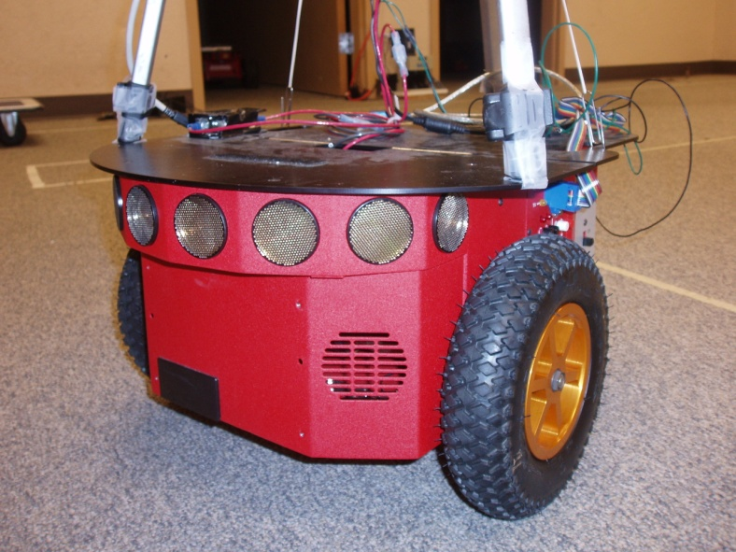
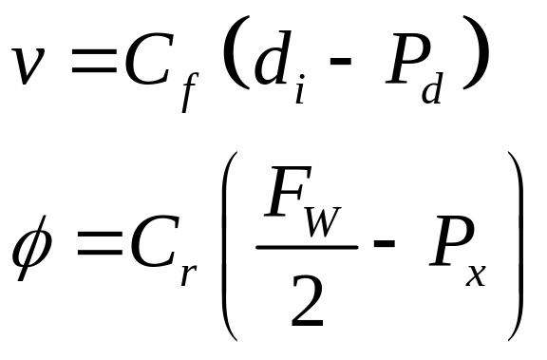
System Overview (Cont.)
Mobile Robot:
  ActivMedia Pioneer P3-DX
  Interface through serial (RS-232) using ActivMedia Robotics Interface for Application (ARIA) API
Robot Control:
  Proportional Controller used to drive robot
  Based on x-position and disparity of the person
  C_{f} = 50 C_{r} = 0.75

Slide 22
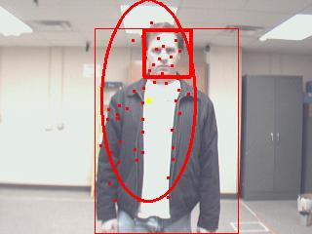
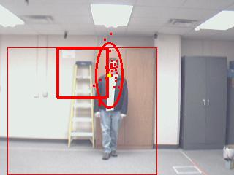
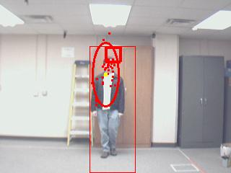
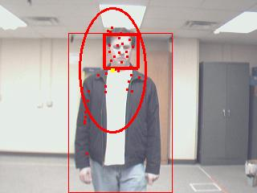
Experimental Results
Frame 110: Person Found
Frame 410: Face Detector Error
Frame 400: Person Tracked against Background
Frame 670: Face Error Corrected

Slide 23
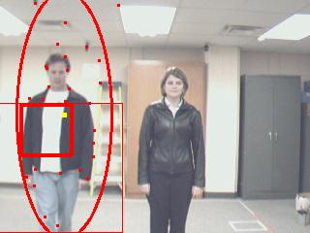
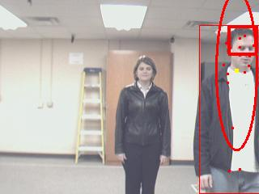
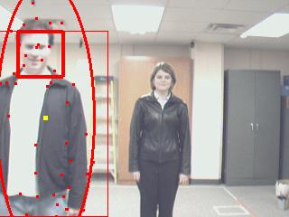
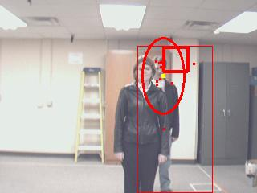
Experimental Results (cont.)
Frame 380: Person Detect (Face Error)
Frame 630: Person Tracked Across Image
Frame 450: Face Corrected
Frame 800: Person Tracked During Partial Occlusion

Slide 24
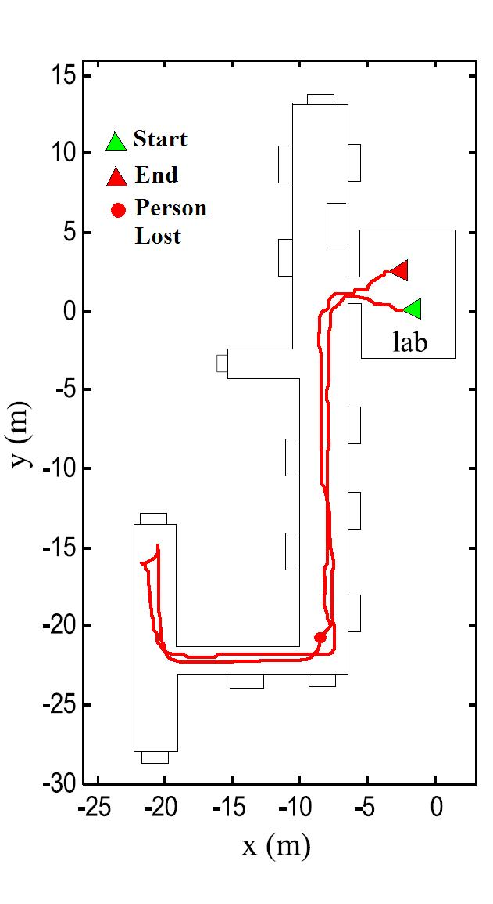
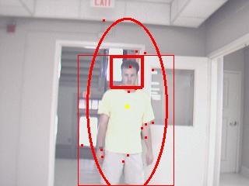
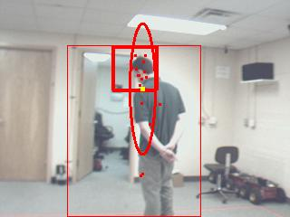
Experimental Results (cont.)
Tracking in a Low Contrast Environment
Tracking during Self-Occlusion and Loss of Face

Slide 25
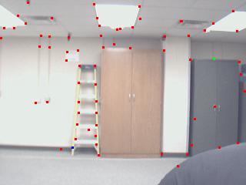
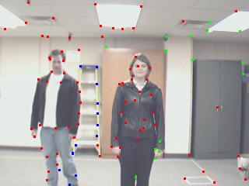
Videos

Slide 26
Algorithm Comparison
Color Based
  Works in low-contrast environments
  Robust to lighting changes
Optical Flow/Motion Based
  Person does not need to move relative to camera
Dense Stereo Matching
  Real time
Pattern Based
  Real time
  Does not require stationary camera

Slide 27
Conclusions & Future Work
Advantages:
  Does not need color
  Can detect person with no relative motion
  Robust to partial and self occlusion
Future Work:
  Less reliance on face, and addition of person qualifiers such as motion estimation
  Testing to determine optimal thresholds
  Application of other clustering methods
  Person classification / recognition

Slide 28
References
[1] Sidenbladh et al., A Person Following Behavior for a Mobile Robot, 1999
[2] Tarokh and Ferrari, Robotic Person Following Using Fuzzy Control for Image Segmentation, 2003
[3] Kwon et al., Person Tracking with a Mobile Robot Using Two Uncalibrated Independently Moving Cameras, 2005
[4] Schlegel et al., Vision Based Person Tracking with a Mobile Robot, 1998
[5] Paggio et al., An Optical-Flow Person Following Behaviour, 1998
[6] Chivilo et al., Follow-the-leader Behavior through Optical Flow Minimization, 2004
[7] Beymer and Konolige, Tracking People from a Mobile Platform, 2001
[8] Viola et al., Detecting Pedestrians Using Patterns of Motion and Appearance, 2003
[9] Lucas and Kanade, An Iterative Image Registration Technique with an Application to Stereo Vision, 1981
[10] Tomasi and Kanade, Detection and Tracking of Point Features, 1991
[11] Viola and Jones, Rapid Object Detection Using a Boosted Cascade of Simple Features, 2001
[12] Chen and Birchfield, Person Following with a Mobile Robot Using Binocular Feature-Based Tracking, 2007

Slide 29
Questions?

